Slide 1
Main Kitchen 1 (existing)
3850
Wall oven & Microwave
Sink
4260
3160
Dishwasher
Fridge
100
1320
580
900
Wall
H 2360
2400

Slide 2
Kitchen 2
2820
2855
1800
Draws
Cupboards
Oven
2950
Overhead cabinetry
2950
Sink
Cupboard
Dishwasher
Fridge
Cupboards
Cupboards
1030
1840

Slide 3
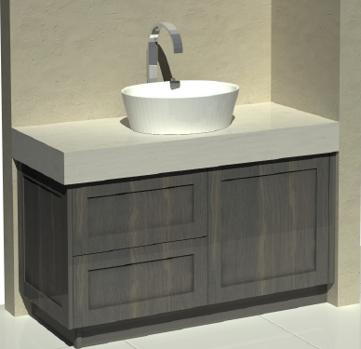
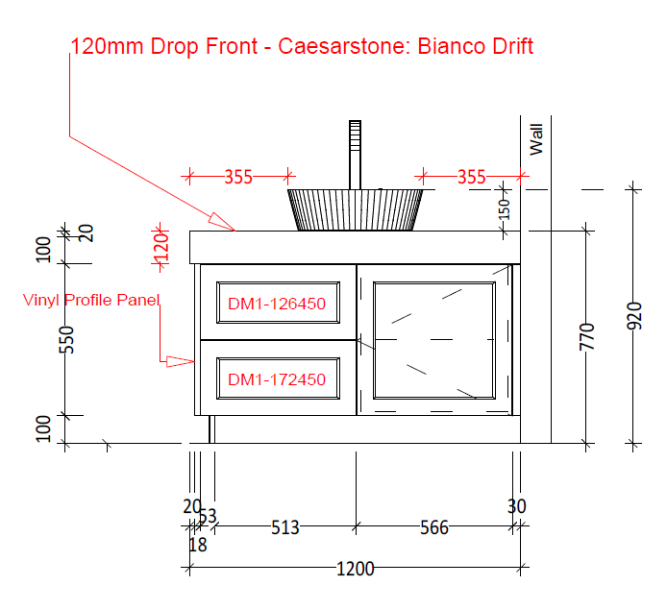
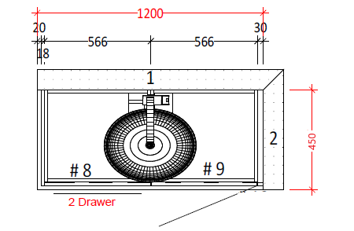
Bathroom vanity (design from existing vanity to be replicated)
Cabinetry to be built using Polytec Botega Oak Woodmatt
Doors and draws with shaker profile

